Slide 1

Power Point Slides
Computer Organisation and Architecture
Smruti Ranjan Sarangi, IIT Delhi
Chapter 6 A Primer On Digital Logic
PROPRIETARY MATERIAL. © 2014 The McGraw-Hill Companies, Inc. All rights reserved. No part of this PowerPoint slide may be displayed, reproduced or distributed in any form or by any means, without the prior written permission of the publisher, or used beyond the limited distribution to teachers and educators permitted by McGraw-Hill for their individual course preparation. PowerPoint Slides are being provided only to authorized professors and instructors for use in preparing for classes using the affiliated textbook. No other use or distribution of this PowerPoint slide is permitted. The PowerPoint slide may not be sold and may not be distributed or be used by any student or any other third party. No part of the slide may be reproduced, displayed or distributed in any form or by any means, electronic or otherwise, without the prior written permission of McGraw Hill Education (India) Private Limited.
1

Slide 2




2nd version
www.basiccomparch.com
Download the pdf of the book
videos
Slides, software, solution manual
The pdf version of the book and all the learning resources can be freely downloaded from the website: www.basiccomparch.com
Print version
(Publisher: WhiteFalcon, 2021)
Available on e-commerce sites.

Slide 3

Outline
Transistors and Gates
Combinational Logic
Sequential Logic
SRAM/ DRAM Cells
3

Slide 4

Disclaimer: This chapter is only to get a high level overview ...
We assume some background in logic gates, transistors, combinational and sequential logic
The aim of this chapter is to only provide a high level overview
For a deeper understanding consult any of the classic textbooks on digital logic

Slide 5

Atoms and Molecules of Circuits
The Transistor
It is just a switch.
It is either switched on (current can flow), or switched off (no current flow)

Slide 6
How is a Transistor Made?
It is made of Silicon
Silicon is a semi-conductor.
We can change its properties:
Add a little bit of impurities → doping
Dope it with Group III elements
Boron, Aluminum and Gallium
It is called a p-type semiconductor
Or, dope it with Group V elements
Phosphorus or Arsenic
It is called a n-type semiconductor

Slide 7
Silicon Lattice
Si
Si
Si
Si
Si
Si
Si
Si
Si
This is a typical silicon lattice. Each Si atom is connected to 4 other atoms.

Slide 8
P-Type Doping
Si
Si
Si
Si
B
Si
Si
Si
Si
If there is a Boron atom in the lattice. It will create bonds with the rest of the atoms.
There will be one less electron (hole)
Holes can flow. They are associated with +ve charge. (see the animation)

Slide 9
N-Type Doping
Si
Si
Si
Si
P
Si
Si
Si
Si
If there is a Phosphorus atom in the lattice. It will create bonds with the rest of the atoms.
There will be one more electron (electron)
Electrons can flow. They are associated with -ve charge. (see the animation)

Slide 10
Let us make a transistor.
gate
source
drain
p-type
n-type
channel
n-type
NMOS transistor → Put two n-type wells in a p-type substrate
Now, assume that we apply +ve charge to the gate.
Channel → This forms because electrons move towards the positive charge. Forms a conductive layer that can conduct current.

Slide 11
NMOS Transistor
drain
gate
Apply a +ve voltage
Current flows from the drain to source
Apply a 0 or -ve voltage
No current flow.
source
We thus have a switch
Apply a +ve voltage at the gate → make the transistor conduct
Apply a –ve or 0 voltage at the gate → transistor is off (no current flow across it)

Slide 12
PMOS Transistor
gate
source
drain
n-type
p-type
channel
p-type
PMOS transistor → Put two p-type wells in an n-type substrate
Now, assume we apply 0 or -ve charge to the gate.
Channel → This forms because holes move towards the gate. This channel can conduct current.

Slide 13
PMOS Transistor
source
gate
Current flows from the source to the drain
Apply a 0 or -ve voltage
Apply a +ve voltage
No current flow.
drain
We thus have a switch
Apply a +ve voltage at the gate → transistor is off (no current flow across it)
Apply a –ve or 0 voltage at the gate →transistor conducts

Slide 14
Let us make an inverter
A
A
V_{cc}
If A = 1 (+ve voltage)
T1 is on, T2 is off
Thus, the output will be connected to the ground, and it will be a logical 0
T2
A
A
T1
If A = 0 (0 voltage)
T1 is off, T2 is on
Thus, the output will be connected to the supply (Vcc), and it will be a logical 1

Slide 15
NOR Gate
V_{cc}
B
A
T4
B
A NOR B
A
T3
Out
A
T1
T2
B
A | B | T1 | T2 | T3 | T4 | Out
0 | 0 | off | off | on | on | 1
1 | 0 | on | off | off | on | 0
0 | 1 | off | on | on | off | 0
1 | 1 | on | on | off | off | 0

Slide 16
NAND Gate
V_{cc}
A
T3
T4
B
Out
B
T2
A
B
A NAND B
A
T1
A | B | T1 | T2 | T3 | T4 | Out
0 | 0 | off | off | on | on | 1
1 | 0 | on | off | off | on | 1
0 | 1 | off | on | on | off | 1
1 | 1 | on | on | off | off | 0

Slide 17
Summary of Logic Gates
A
A
B
A AND B
B
A OR B
A
A
B
A NAND B
B
A NOR B
A
A

Slide 18
Outline
Transistors and Gates
Combinational Logic
Sequential Logic
SRAM/ DRAM Cells
18

Slide 19
Multiplexer
Given n inputs, choose one based on the select bits.
Example: Given 8 inputs, 3 select bits, choose 1 among them
log(n) select bits
Output
MUX
n inputs
19

Slide 20
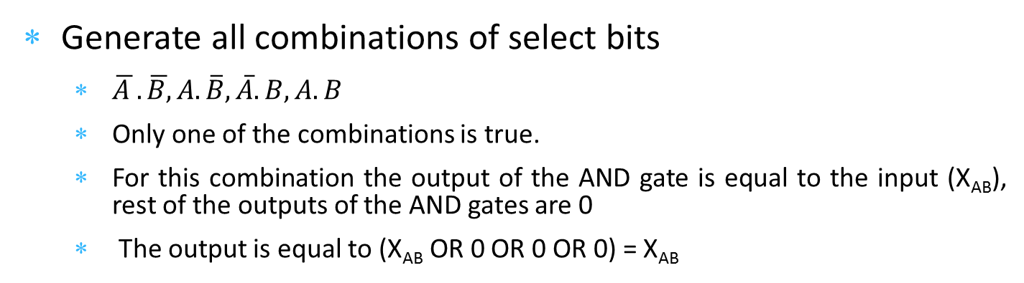
Design of a Multiplexer
A
B
X
00
Select bits: A and B
A
B
X
01
A
Output
inputs
B
X
10
A
B
X
11
Generate all combinations of select bits
$\overline{A }.\overline{B,}A.\overline{B}, \overline{A}.B, A.B$
Only one of the combinations is true.
For this combination the output of the AND gate is equal to the input (X_{AB}), rest of the outputs of the AND gates are 0
The output is equal to (X_{AB} OR 0 OR 0 OR 0) = X_{AB}
20

Slide 21
Demultiplexer
Given 1 input, make it appear on one of n outputs. The output is decided by log(n) select bits
A
Outputs
B
A
B
Input
A
B
A
B
21

Slide 22
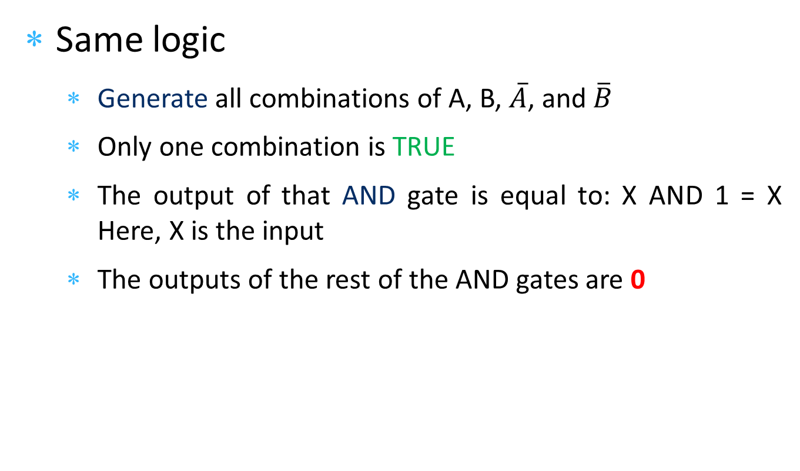
Working of a Demultiplexer
Same logic
Generate all combinations of A, B, $\overline{A}$, and $\overline{B}$
Only one combination is TRUE
The output of that AND gate is equal to: X AND 1 = X Here, X is the input
The outputs of the rest of the AND gates are 0

Slide 23
Decoder
Set one of the n outputs to 1. The output is decided by log(n) select bits
A
Outputs
B
A
B
A
B
A
B
Operation is similar to a demultiplexer
23

Slide 24
Encoder
Given n inputs, assume only one of them is 1. Find its id.
For example: if the 6th input out of 8 inputs is 1. The output should be 110
Encoder
log(n) bits
n inputs

Slide 25
Example of a 3-bit Encoder
Output bits
Input bit | Bit2 | Bit1 | Bit0
b0 | 0 | 0 | 0
b1 | 0 | 0 | 1
b2 | 0 | 1 | 0
b3 | 0 | 1 | 1
b4 | 1 | 0 | 0
b5 | 1 | 0 | 1
b6 | 1 | 1 | 0
b7 | 1 | 1 | 1
Here, the + symbol stands for OR
Bit2 = b4 + b5 + b6 + b7
Bit1 = b2 + b3 + b6 + b7
Bit0 = b1 + b3 + b5 + b7

Slide 26
Example of a 3-bit Encoder - II
b4
Bit2
b5
b6
b7
b2
Bit1
b3
Outputs
8-bit input
b6
b7
b1
Bit0
b3
b5
b7

Slide 27
Outline
Transistors and Gates
Combinational Logic
Sequential Logic
SRAM/ DRAM Cells
27

Slide 28



SR Latch
Use a cross-coupled pair of NAND gates to store a stable value.
S → Set
R → Reset
S
Q
Q
R
Understand these points
S = 1, R = 0, Q = 1
S = 0, R = 1, Q = 0
S = 0, R = 0, <maintain old values>
Set the values
28

Slide 29
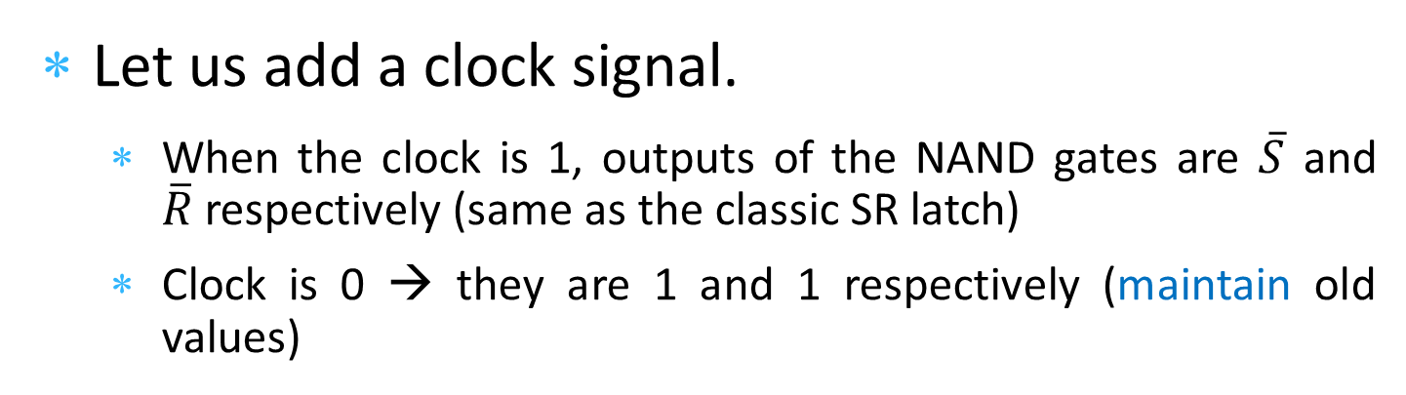
Clocked SR Latch
S
Q
Clock
Q
R
Let us add a clock signal.
When the clock is 1, outputs of the NAND gates are $\overline{S}$ and $\overline{R}$respectively (same as the classic SR latch)
Clock is 0 → they are 1 and 1 respectively (maintain old values)
29

Slide 30
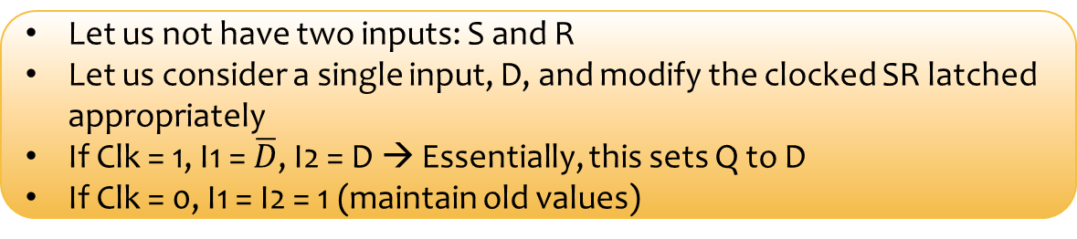
D Flip Flop
D
I1
Q
Clk
I2
Q
D = 1, Q = 1
D = 0, Q = 0
Let us not have two inputs: S and R
Let us consider a single input, D, and modify the clocked SR latched appropriately
If Clk = 1, I1 = $\overline{D}$, I2 = D → Essentially, this sets Q to D
If Clk = 0, I1 = I2 = 1 (maintain old values)
30

Slide 31
Master Slave D Flip Flop
Connect two D flip flops one after the other
master
D'
slave
D
Q
Clk
Clk
Q
1
D’ = D
Note the importance of the negative edge
Clk
0
Q = D’
When the Clk = 1, the value of D gets transferred to the slave (D’)
Then when the Clk transitions to 0 (1 → 0)
The value of D’ gets transferred to the output (Q)
31

Slide 32
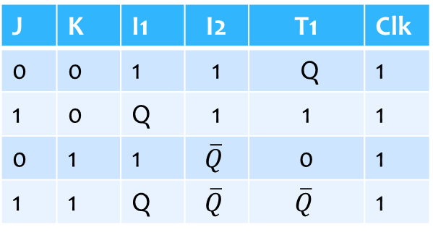
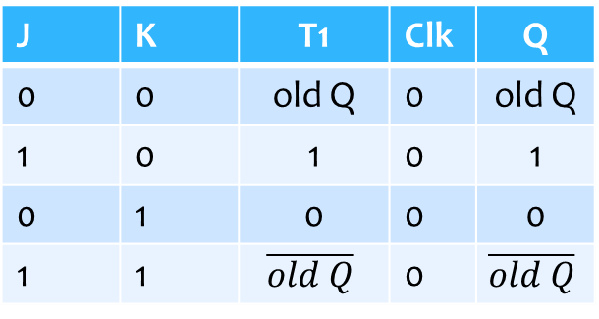

Master Slave J-K Flip Flop
master
slave
T1
J
I1
Q
Clk
Clk
I2
Q
K
$$\overline{T1}$$
master is active
slave is active
J | K | I1 | I2 | T1 | Clk
0 | 0 | 1 | 1 | Q | 1
1 | 0 | Q | 1 | 1 | 1
0 | 1 | 1 | $$\overline{Q}$$ | 0 | 1
1 | 1 | Q | $$\overline{Q}$$ | $$\overline{Q}$$ | 1
J | K | T1 | Clk | Q
0 | 0 | old Q | 0 | old Q
1 | 0 | 1 | 0 | 1
0 | 1 | 0 | 0 | 0
1 | 1 | $$\overline{old Q}$$ | 0 | $$\overline{old Q}$$
Maintain, Set, Reset, or Toggle
Transfer the input to the output

Slide 33
Outline
Transistors and Gates
Combinational Logic
Sequential Logic
SRAM/ DRAM Cells
33

Slide 34

SRAM Cell
We want to reduce the number of transistors required to store a single bit
Instead of using a cross-coupled pair of NAND gates, use a cross coupled pair of inverters
A pair of inverters stores 1 bit
Problems: Need extra circuitry to read and write values

Slide 35
SRAM Cell
Word line (WL)
v
dd
W1
W2
cross coupled
pair of inverters
BL
BL
(Bit line)
35

Slide 36

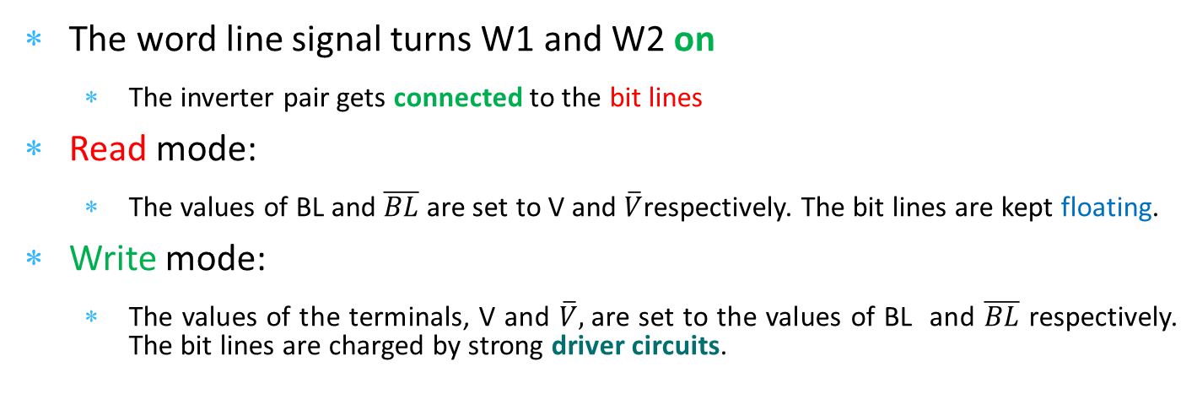
SRAM Cell (Alternative Reprsentation)
6 Transistor SRAM cell
V
$$\overline{V}$$
BL
W1
W2
BL
word line
The word line signal turns W1 and W2 on
The inverter pair gets connected to the bit lines
Read mode:
The values of BL and $\overline{BL}$ are set to V and $\overline{V}$respectively. The bit lines are kept floating.
Write mode:
The values of the terminals, V and $\overline{V},$are set to the values of BL and $\overline{BL}$ respectively. The bit lines are charged by strong driver circuits.
Not connected to ground or Vcc

Slide 37

Array of SRAM Cells
To save space, we arrange SRAM cells into rows and columns
Use a decoder to set only one word line to 1 (based on the address)
BL
BL
WL
D
E
C
O
D
E
R
SRAM
SRAM
SRAM
SRAM
cell
cell
cell
cell
Setting a word line enables all the cells in a row
Address
WL
SRAM
SRAM
SRAM
SRAM
cell
cell
cell
cell
Only one row can be enabled at a time
WL
SRAM
SRAM
SRAM
SRAM
cell
cell
cell
cell
Choose a subset of columns to read or write
Address
Column mux/demux
Write
Write
driver
driver
Data in
Data in
Sense amplifier
Sense amplifier
Data out
37

Slide 38
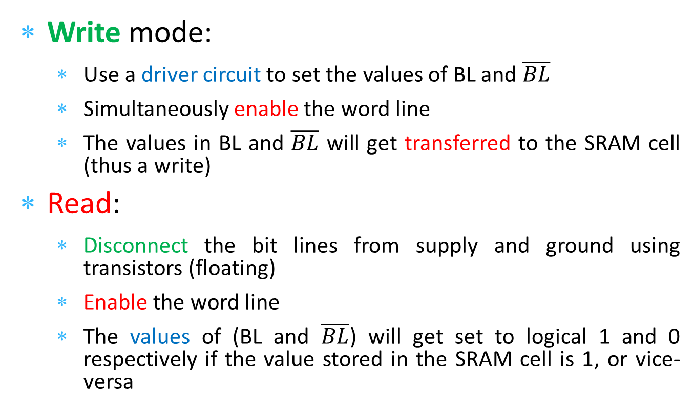
Operating an Array of SRAM Cells
Write mode:
Use a driver circuit to set the values of BL and $\overline{BL}$
Simultaneously enable the word line
The values in BL and $\overline{BL}$ will get transferred to the SRAM cell (thus a write)
Read:
Disconnect the bit lines from supply and ground using transistors (floating)
Enable the word line
The values of (BL and $\overline{BL}$) will get set to logical 1 and 0 respectively if the value stored in the SRAM cell is 1, or vice-versa

Slide 39

Pre-charging
Issues with the simple design:
The bit lines are very long, and are connected to a lot of SRAM cells
They thus have a lot of resistance and capacitance
Driving them to a logical 0 or 1 (typically 1V) will take a long time
This will make the SRAM slow
Can we do something better
Observe:
Let us pre-charge both the bitlines to 0.5 V (assuming logical 1 is 1V) using strong pre-charge driver circuits
Let us then enable the word line
One of the bit lines will move towards 0V and the other towards 1V
IDEA: Monitor the difference in voltages between the bit lines

Slide 40

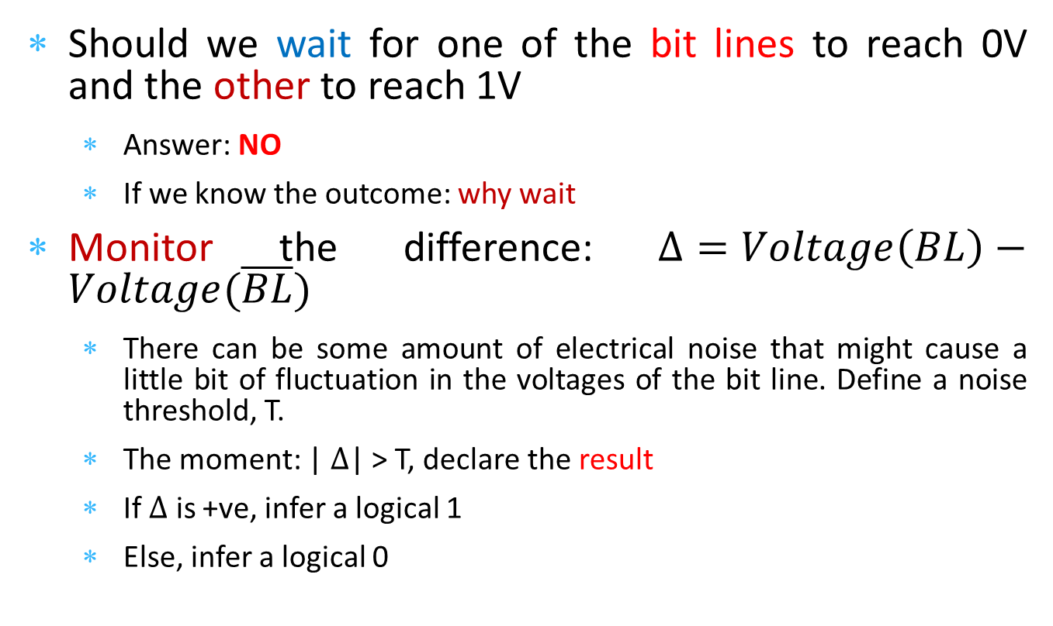
Pre-charging - II
Should we wait for one of the bit lines to reach 0V and the other to reach 1V
Answer: NO
If we know the outcome: why wait
Monitor the difference: $Δ=Voltage\left(BL\right)−Voltage(\overline{BL})$
There can be some amount of electrical noise that might cause a little bit of fluctuation in the voltages of the bit line. Define a noise threshold, T.
The moment: | $Δ$| > T, declare the result
If $Δ$ is +ve, infer a logical 1
Else, infer a logical 0
A very fast method of reading

Slide 41
Array of SRAM Cells
BL
BL
WL
D
E
C
O
D
E
R
Pre-charge
drivers
SRAM
SRAM
SRAM
SRAM
cell
cell
cell
cell
Address
WL
SRAM
SRAM
SRAM
SRAM
cell
cell
cell
cell
WL
SRAM
SRAM
SRAM
SRAM
cell
cell
cell
cell
Address
Column mux/demux
Write
Write
Write
drivers
driver
driver
Data in
Data in
Sense amplifier
Sense amplifier
Sense amplifiers to monitor the difference in voltages
Data out
41

Slide 42
DRAM Cell (even smaller)
Word line (WL)
Capacitor is charged → logical 1
No charge across the capacitor → 0
BL
(Bit line)
42

Slide 43
Array of DRAM Cells
Features
There is a single bit line
For writing → Enable the word line and charge the bit line with a driver circuit
For reading → pre charge the bit line to 0.5 V, enable the word line, and monitor the difference of the voltage w.r.t 0.5 V
If the difference in voltages exceeds a threshold
Infer a logical 0 or 1 depending on the sign of the difference

Slide 44
DRAM Refresh
Problems
After every read, we lose some charge from the capacitor
Periodically, charge from the capacitor leaks out
Hence, it is necessary to:
Periodically read each and every DRAM cell
And write the same data back
Example: The charge across the capacitor reduces from 1 V to 0.7 V over time.
Let’s say, this is enough to infer a logical 1.
Read the value (logical 1 in this case)
And write the same value again. We thus restore the charge on the capacitor to 1 V.
This is known as DRAM refresh

Slide 45
Array of DRAM Cells
BL
WL
DRAM
DRAM
DRAM
DRAM
cell
cell
cell
cell
Address
WL
Decoder
DRAM
DRAM
DRAM
DRAM
cell
cell
cell
cell
WL
DRAM
DRAM
DRAM
DRAM
cell
cell
cell
cell
Address
Column mux/demux
Refresh
Refresh
Note the refresh circuits
Write
Write
driver
driver
Data in
Data in
The rest is the same as the SRAM array
Sense amplifier
Sense Amplifier
Data out
45

Slide 46
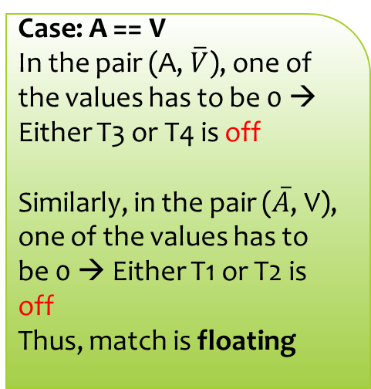
CAM Cell
Instead of enabling cells by their address, can we find them by their contents?
Content Addressable
Memory → CAM
SRAM cell
Case: A == V
In the pair (A, $\overline{V}$), one of the values has to be 0 → Either T3 or T4 is off
Similarly, in the pair ($\overline{A}$, V), one of the values has to be 0 → Either T1 or T2 is off
Thus, match is floating
A
A
BL
BL
Word line (WL)
v
dd
W1
W2
V
V
match
T1
T3
T2
T4
Content matching circuit
46

Slide 47
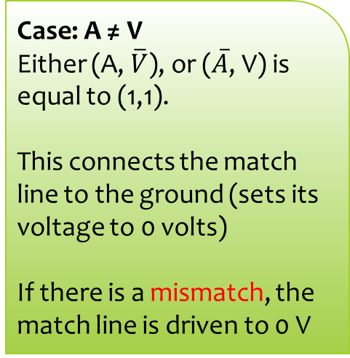
CAM Cell
Instead of enabling cells by their address, can we find them by their contents?
Content Addressable
Memory → CAM
SRAM cell
Case: A ≠ V
Either (A, $\overline{V}$), or ($\overline{A}$, V) is equal to (1,1).
This connects the match line to the ground (sets its voltage to 0 volts)
If there is a mismatch, the match line is driven to 0 V
A
A
BL
BL
Word line (WL)
v
dd
W1
W2
V
V
match
T1
T3
T2
T4
Content matching circuit
47

Slide 48
Array of CAM Cells
A
A
A
A
A
A
Pre-charge all the match lines to 1
CAM mode
1
BL
1
2
BL
2
n
BL
n
BL
BL
BL
WL
CAM
CAM
CAM
cell
cell
cell
match
If there is a content match, one of the match lines will be 1
Address
Decoder
WL
CAM
CAM
CAM
cell
cell
cell
The OR gate will thus compute 1 (else 0 if none of the rows match)
WL
CAM
CAM
CAM
cell
cell
cell
Address
Column mux/demux
Write
Write
driver
driver
Data in
Data in
Sense amplifier
Sense amplifier
match
Data out
48

Slide 49
Array of CAM Cells - II
A
A
A
A
A
A
CAM mode
1
BL
1
2
BL
2
n
BL
n
BL
BL
BL
WL
CAM
CAM
CAM
cell
cell
cell
match
Address
Decoder
WL
CAM
CAM
CAM
cell
cell
cell
Use an encoder to find the id of the row that matched.
WL
CAM
CAM
CAM
cell
cell
cell
Address
Column mux/demux
Write
Write
Encoder
driver
driver
Data in
Data in
Sense amplifier
Sense amplifier
Id of the row
that matched
Data out
49

Slide 50
THE END
50

